Slide 1
An Indian Restaurant In New York City
-By Gayatri Snigdha

Slide 2
Introduction
In Coursera we work with real datasets to get experience of what a real data scientist go through in the real life. Objectives of the final assignments were to define a business problem, look for data in the web and, use Foursquare location data to compare different neighbourhoods of New York city to figure out which neighborhood is suitable for starting a new Indian restaurant . In this project, I go through all the process in a step by step manner from problem designing, data preparation to final analysis and finally will provide a conclusion that can be leveraged by the business stakeholders to make their decisions.

Slide 3
Prospects of opening an Indian restaurant in New York city:
New York City comprises 5 boroughs sitting where the Hudson River meets the Atlantic Ocean. At its core is Manhattan, a densely populated borough that’s among the world’s major commercial, finan8cial and cultural centers. Its iconic sites include skyscrapers such as the Empire State Building and sprawling Central Park. Broadway theater is staged in neon-lit Times Square. In this project we will go through a step bey step process to decide where to open an Indian restaurant.We will analyse the real dataset of neighborhoods in New York City to identify the correct and profitable place for an Indian restaurant.

Slide 4
Target Audience
1.Business personnel who wants to invest or open an Indian restaurant in New York city. This analysis will be a comprehensive guide to start or expand restaurants targeting the Indian crowd.
2.Freelancer who loves to have their own restaurant as a side business. This analysis will give an idea, how beneficial it is to open a restaurant and what are the pros and cons of this business.
3.Indian crowd who wants to find neighbourhoods with lots of option for Indian restaurants.
4.Business Analyst or Data Scientists, who wish to analyse the neighbourhoods of New York using Exploratory Data Analysis and other statistical & machine learning techniques to obtain all the necessary data, perform some operations on it and, finally be able to tell a story out of it.
5.For the food enthusiasts who are interested in multi cuisines

Slide 5
Data Sources
For this project we need the following data :
• New York City data that contains list Boroughs, Neighborhoods along with their latitude and longitude.
▪ Data source : https://cocl.us/new_york_dataset
▪ Description : This data set contains the required information. And we will use this data set to explore various neighborhoods of New York city.
• Indian restaurants in each neighborhood of new york city.
▪ Data source : Foursquare API
▪ Description : By using this api we will get all the venues in each neighborhood. We can filter these venues to get only indian restaurants.
• GeoSpace data
▪ Data source : https://data.cityofnewyork.us/City-Government/Borough-Boundaries/tqmj-j8zm
▪ Description : By using this geo space data we will get the New York Borough boundaries that will help us visualize choropleth map.

Slide 6
Approach
Collect the new york city data from https://cocl.us/new_york_dataset
Using FourSquare API we will find all venues for each neighborhood.
Filter out all venues that are Indian Resturants.
Find rating , tips and like count for each Indian Resturants using FourSquare API.
Using rating for each resturant , we will sort that data.
Visualize the Ranking of neighborhoods using folium library(python)

Slide 7
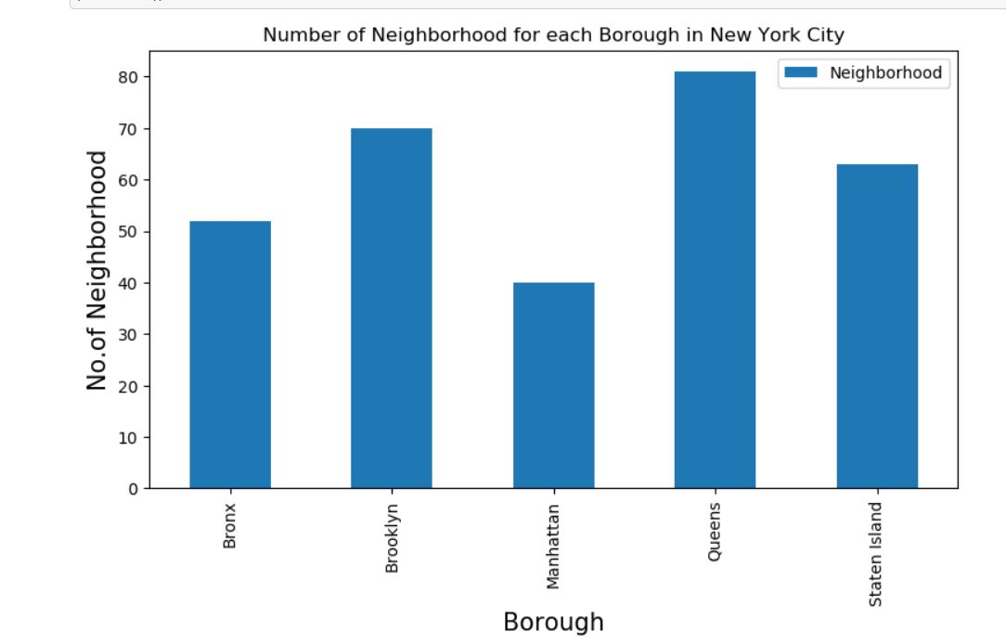
Exploratory Analysis
We use matplotlib library to see neighbourhoods of New York city

Slide 8
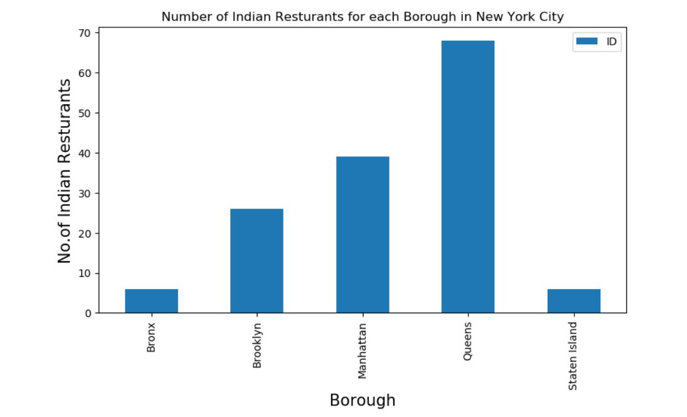
By using Foursquare we have explored some Indian venues in New York city and we plotted the number of Indian restaurants using bar graph.

Slide 9
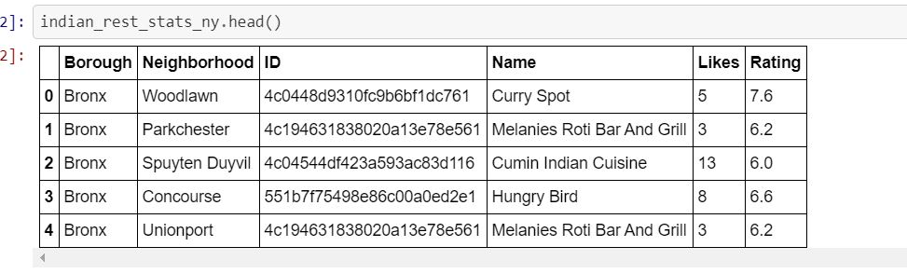
We can see that Queens has the largest number of Indian restaurants in the New York city.
Now we used Foursquare API to explore ratings and likes for each Indian restaurant

Slide 10
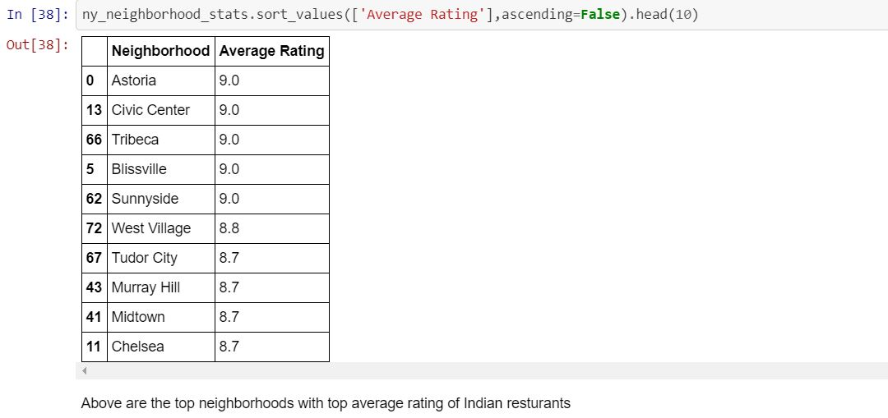
We took average ratings of the Indian restaurants

Slide 11
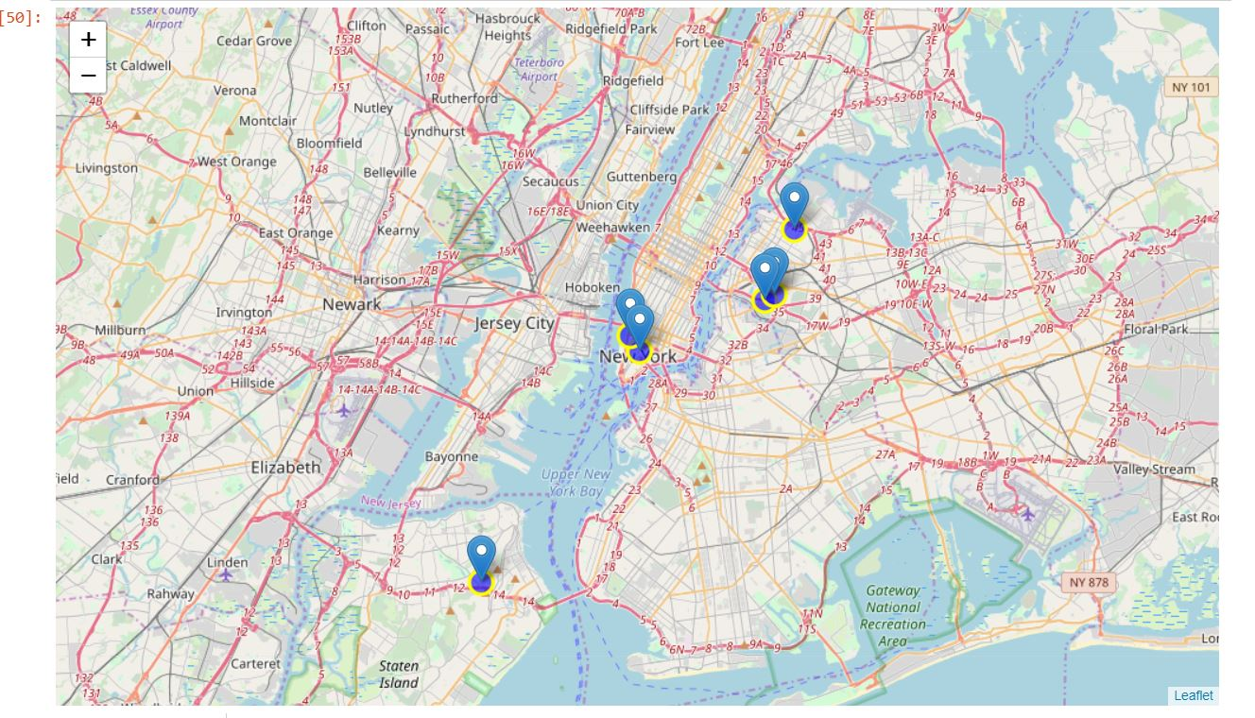
We will join the above dataset to original New York data to get the longitude and latitude. And then we will visualise a map using folium

Slide 12
Result section
Astoria(Queens), Blissville(Queens), Civic Center(Manhattan) are some of the best neighborhoods for indian cuisine.
Manhattan have potential Indian Resturant Market/
Staten Island ranks last in average rating of Indian Resturants.
Manhattan is the best place to stay if you prefer Indian Cuisine.

Slide 13
Limitations
The ranking is purely on basis of rating of restaurants.
The accuracy of data depends purely depends on the data provided by Foursquare.

